Slide 1
Power Points for 412 RIP and Fives Sixes and Sevens
Bb players play tracks using a C or G Eb players use G

Slide 2
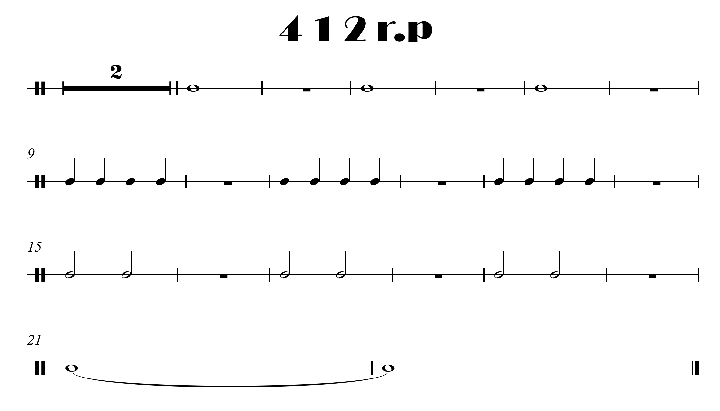

Hold for 8 counts at the end

Slide 3
