Slide 1
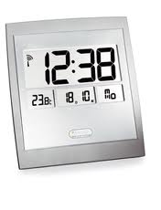
Alarm Clock Rock
1 | rest | rest | rest | x 4
1 | 2 | rest | rest | x 4
1 | 2 | 3 | rest | x 4
Long 4 | long rest | x | 4

Slide 2

Alarm Clock Rock
1 | rest | rest | rest | x 4
1 | 2 | rest | rest | x 4
1 | 2 | 3 | rest | x 4
Long 4 | long rest | x | 4
1 | rest | rest | rest | rest | rest | rest | rest | X 3

Slide 3





I Beat Note
1 Beat Rest
4 beat note
4 beat rest

Slide 4
Alarm Clock Rock
 |  |  |  | x 4
 |  |  |  | x 4
 |  |  |  | x 4
 |  | x | 4
 |  |  |  |  |  |  |  | X 3

