Slide 1
C Bass Blues
art work by Julie Burton

Slide 2
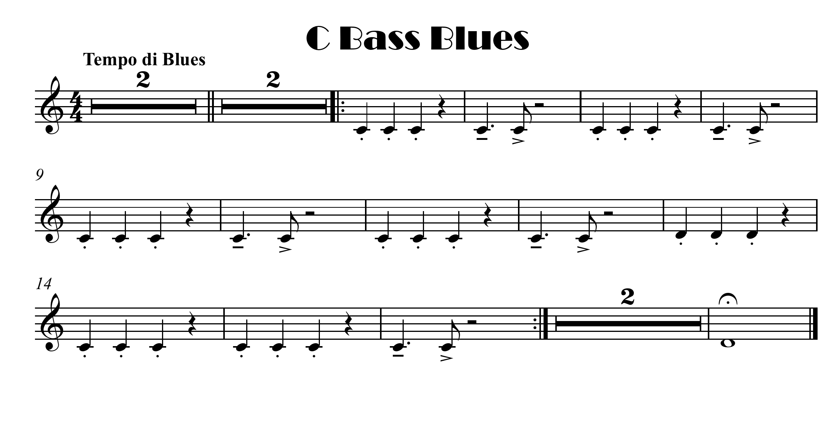


click here for note names

Slide 3


Slide 4
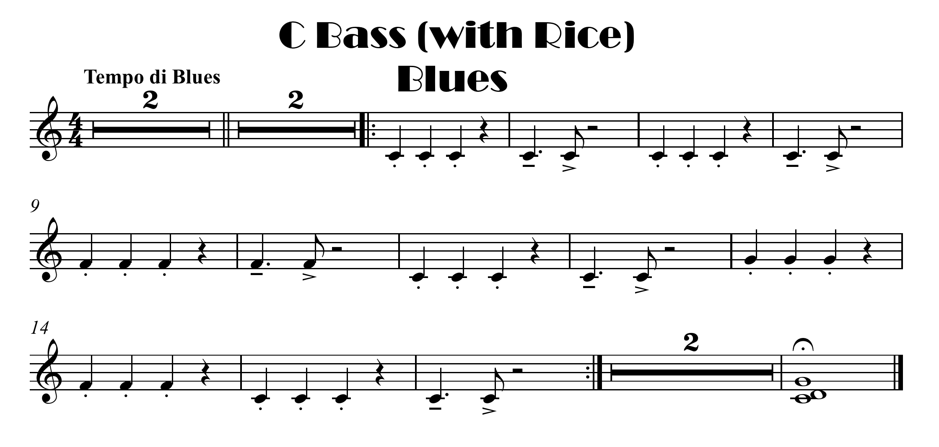
Spot The Difference ?
click here for note names

Slide 5
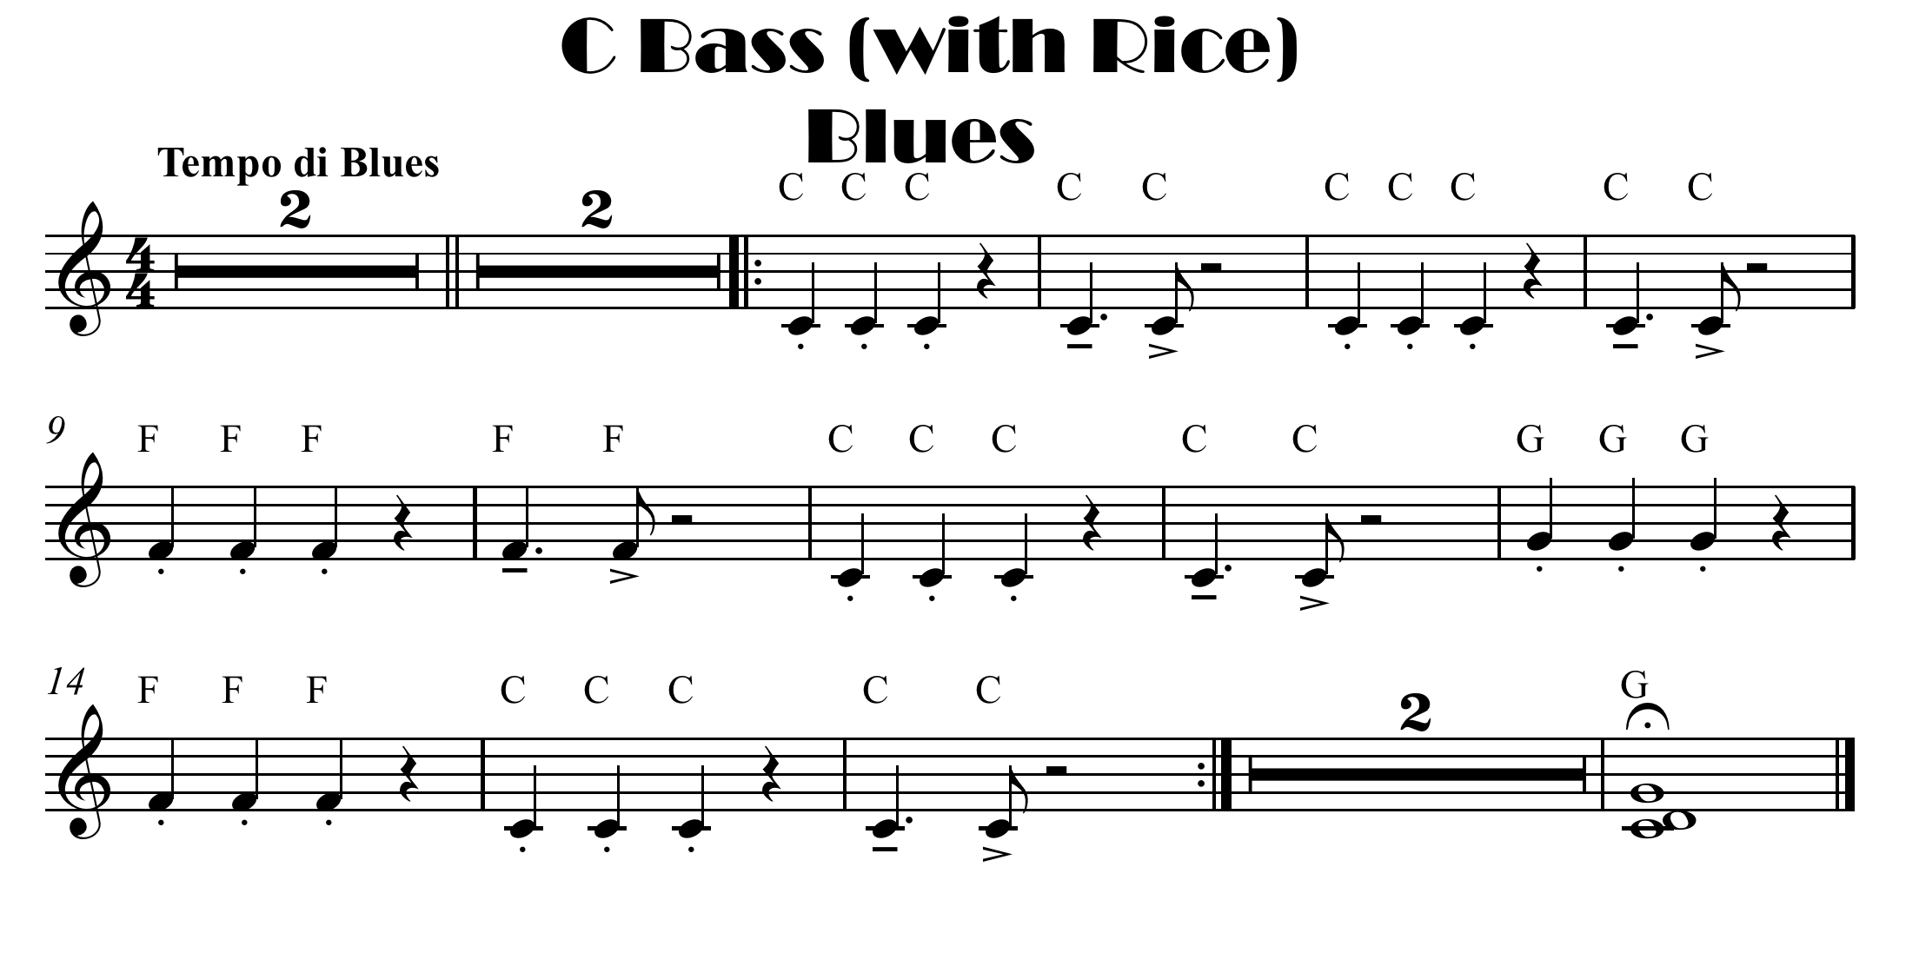

Slide 6

click here for note names

Slide 8
click here for note names

