Slide 1

On The Right Track
New Tunes for Brass
WCIT Edition

Slide 2
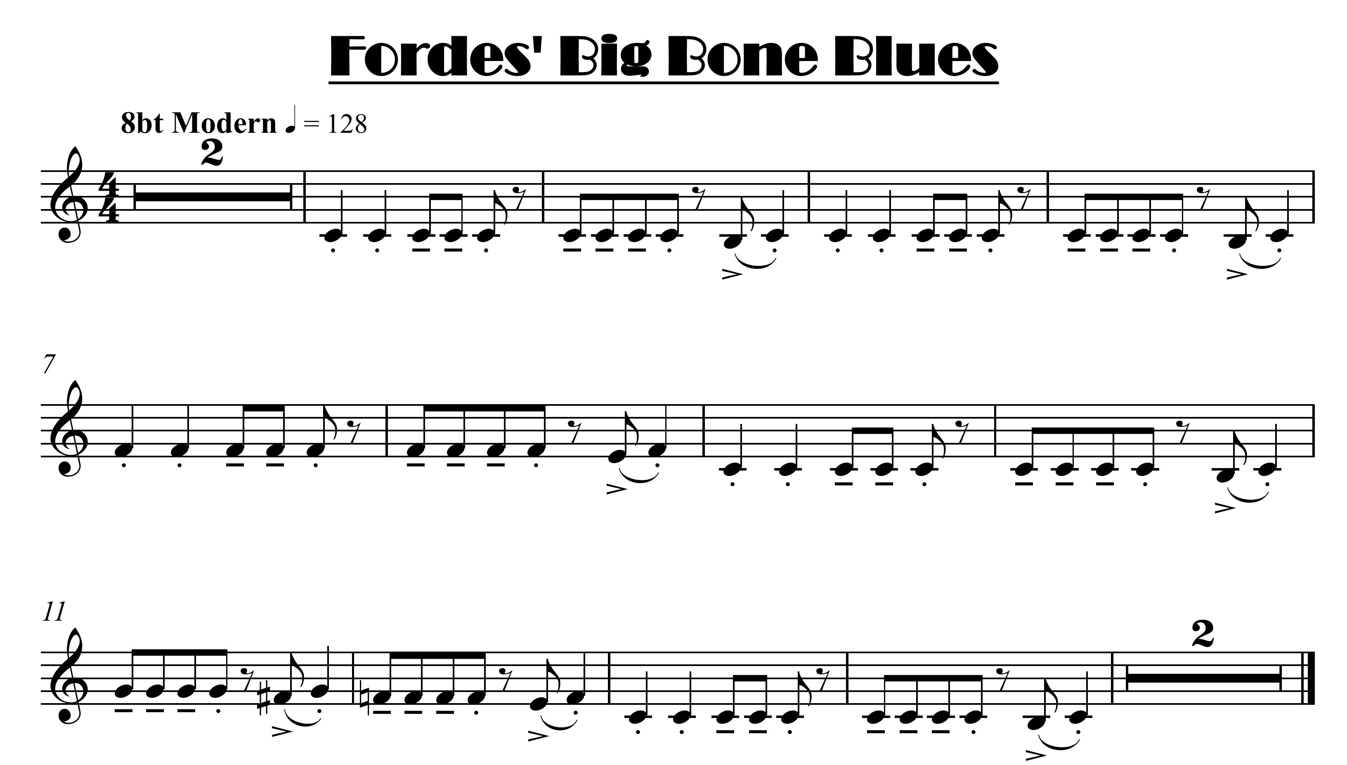


click here for note names

Slide 3
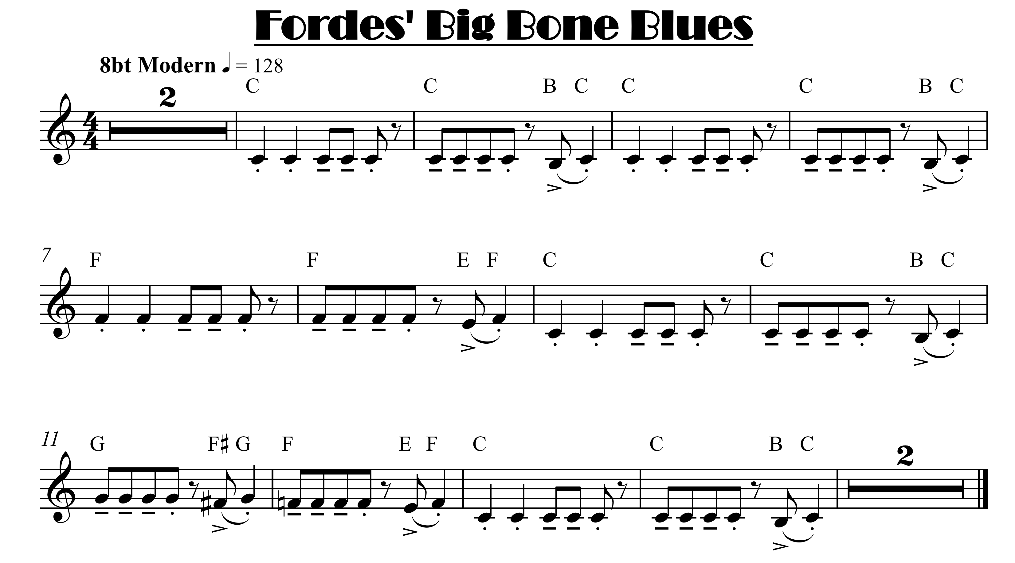

Slide 4
click here for note names
Faster version repeats

Slide 6

click here for note names

Slide 8
click here for note names
Faster version repeats

