Slide 1

On The Right Track
New Tunes for Brass
WCIT Edition

Slide 3
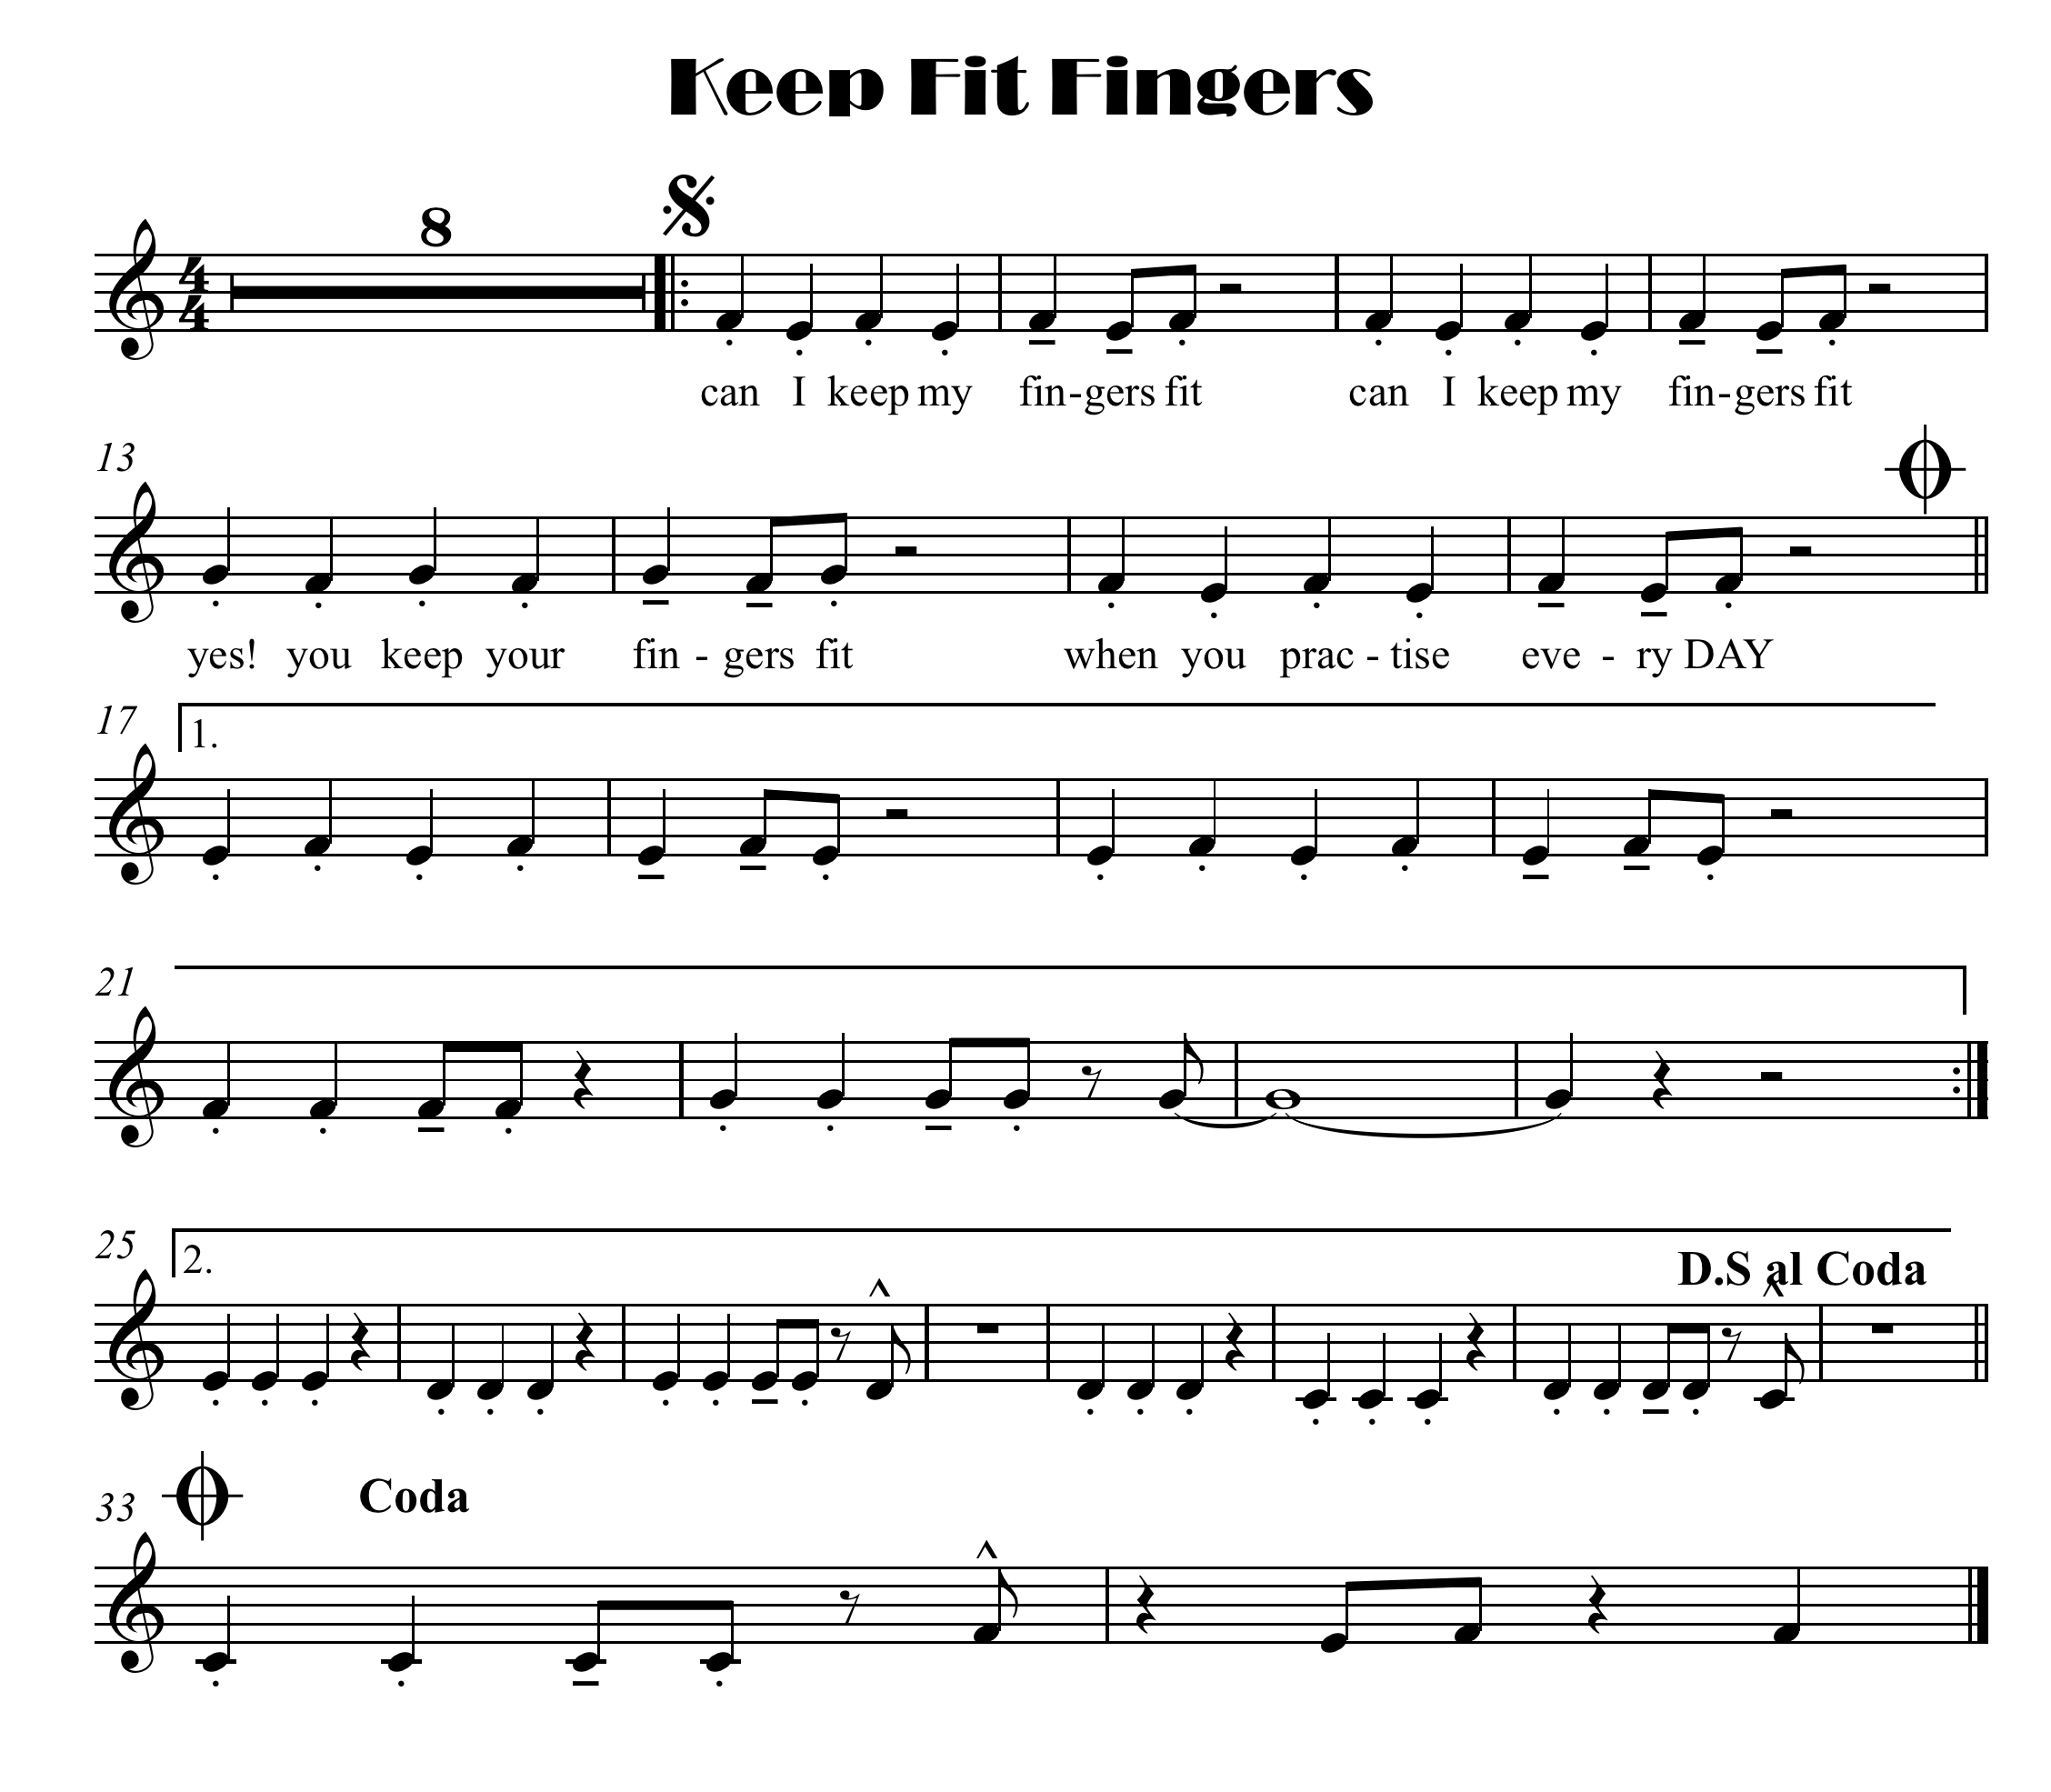



Slide 4
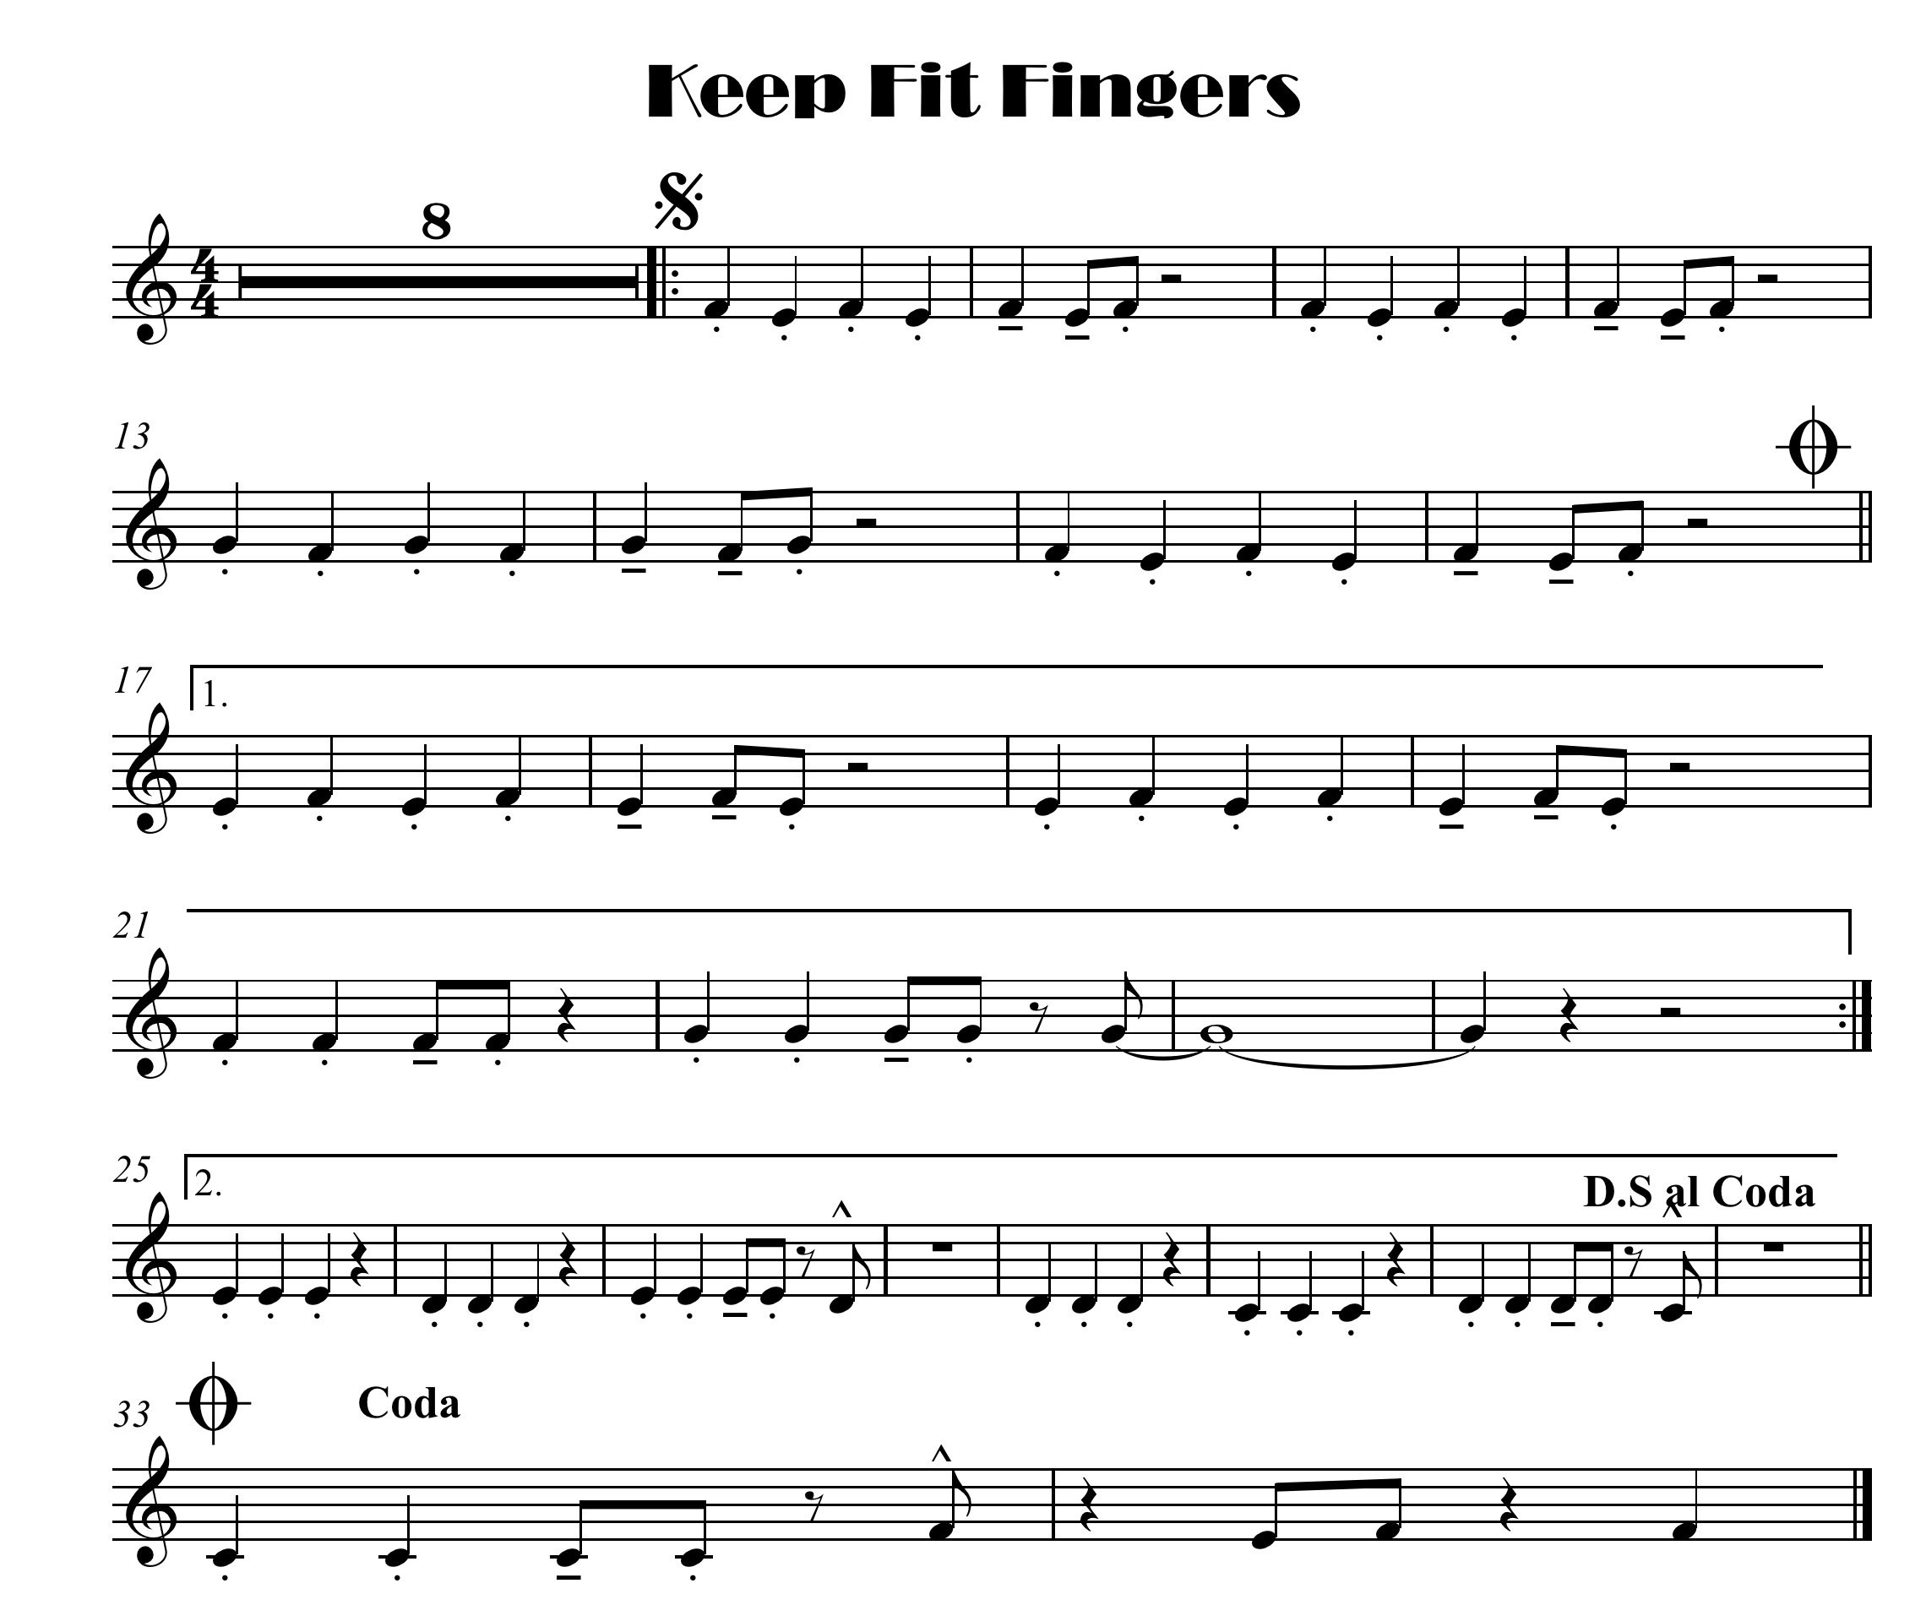
click here for note names

Slide 5
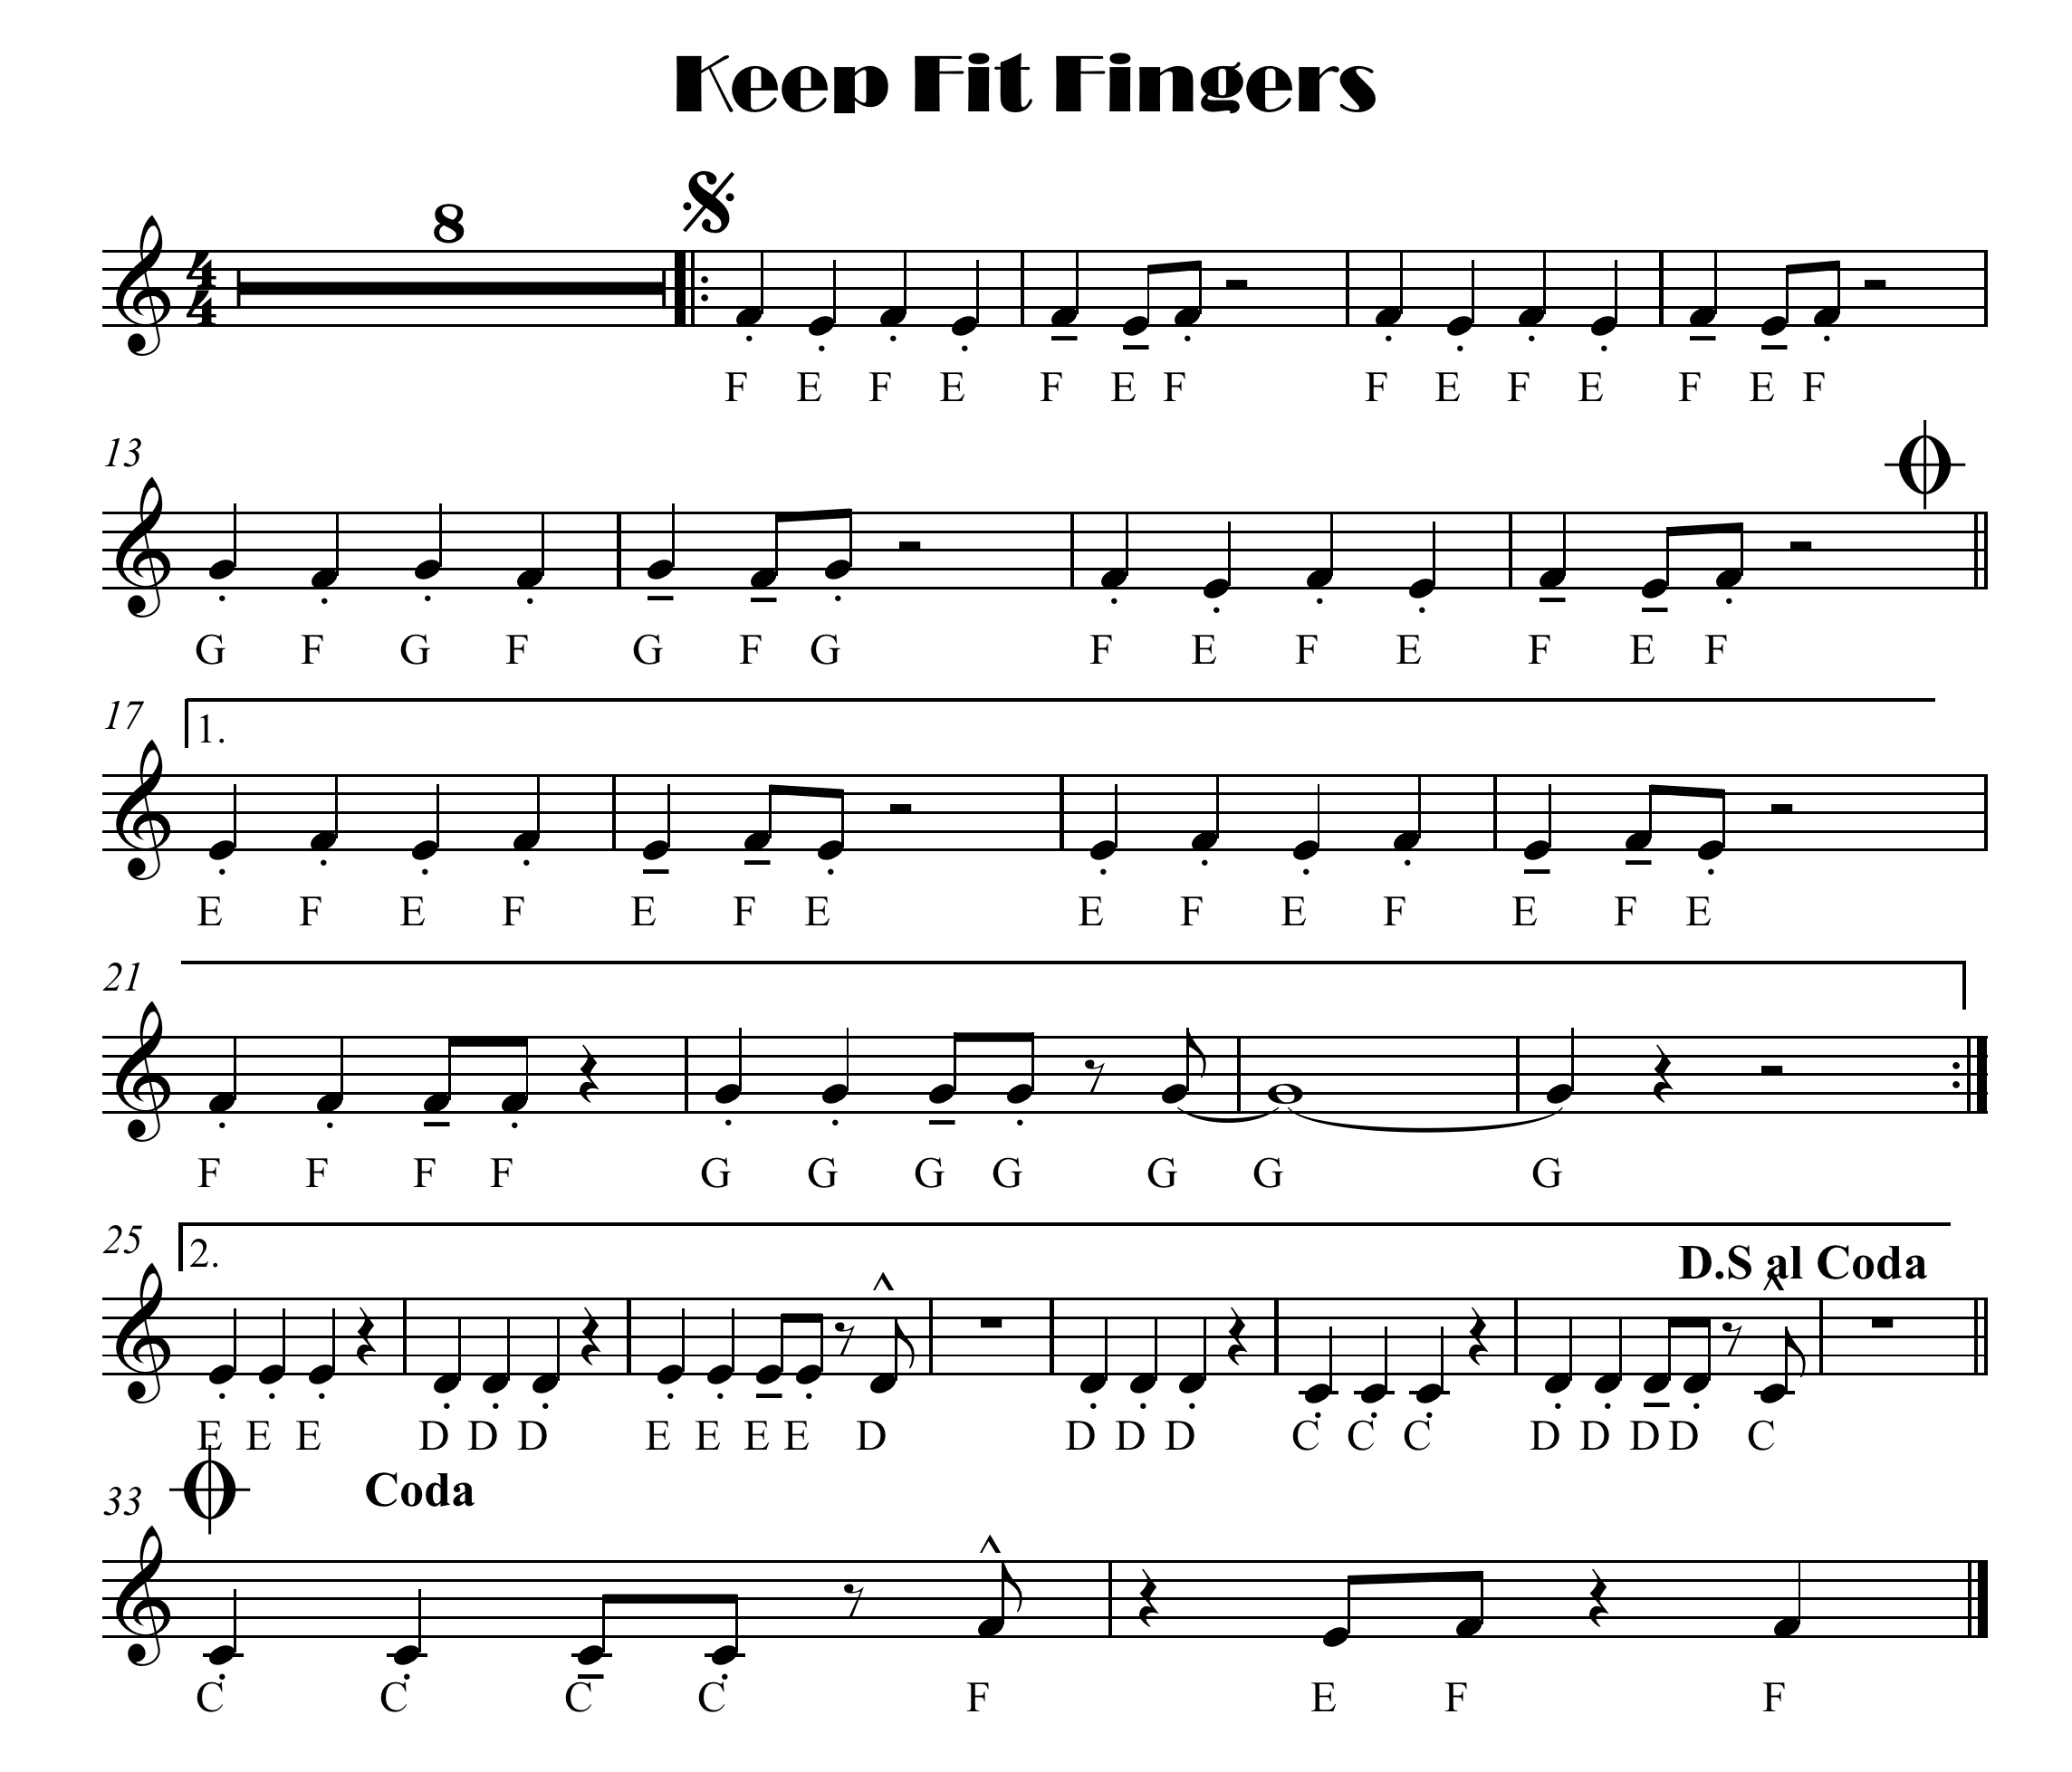

Slide 6

click here for note names

