Slide 1

On The Right Track
New Tunes for Brass
WCIT Edition

Slide 2
art work by Julie Burton

Slide 3
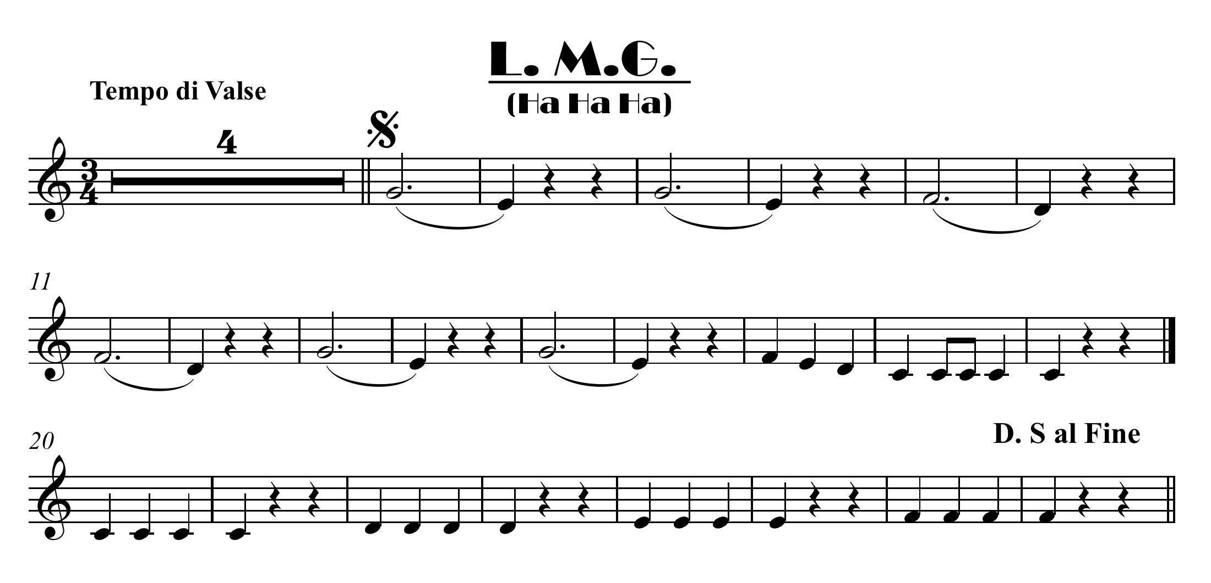


click here for note names

Slide 4
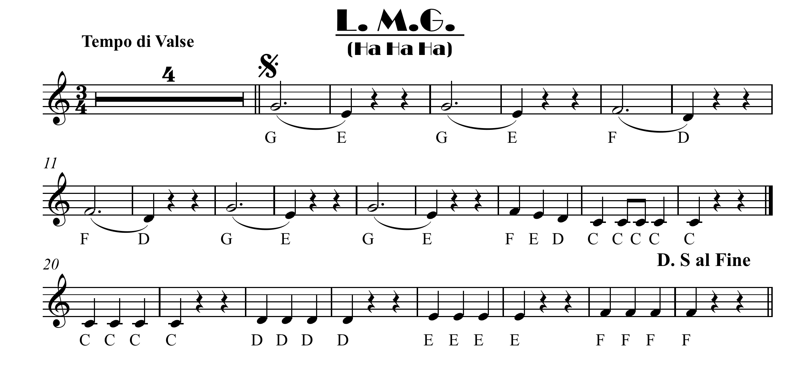

Slide 5
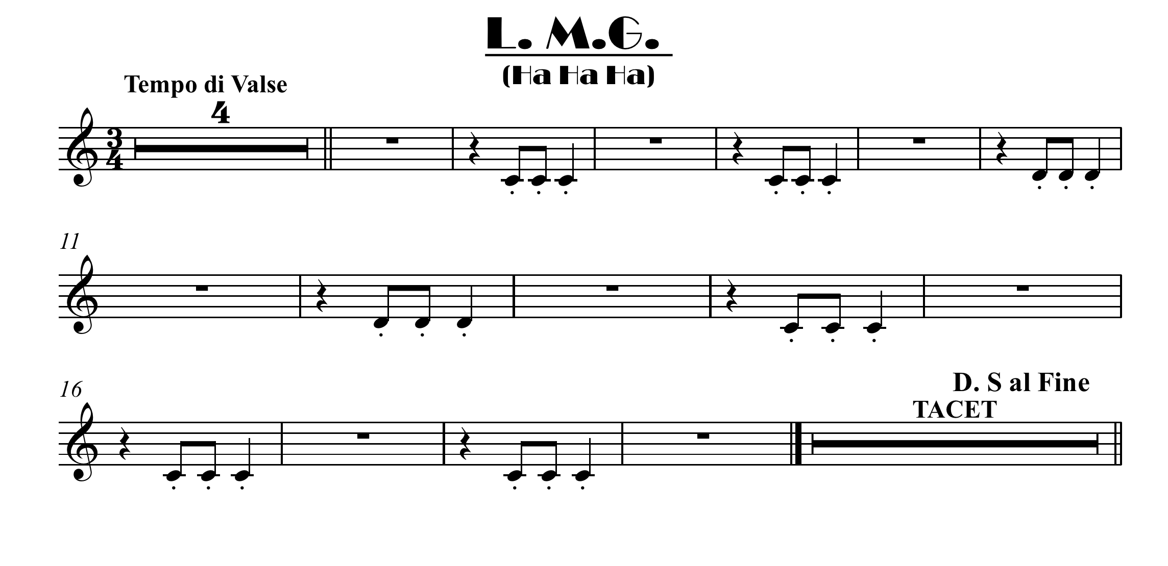
Easy ensemble part Bb

Slide 6
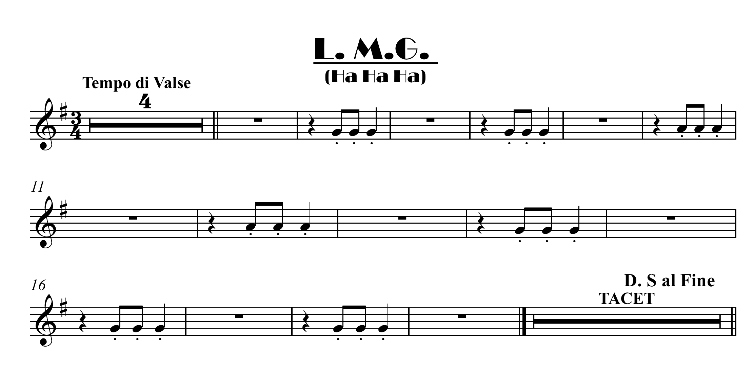
Easy ensemble part Eb

Slide 7
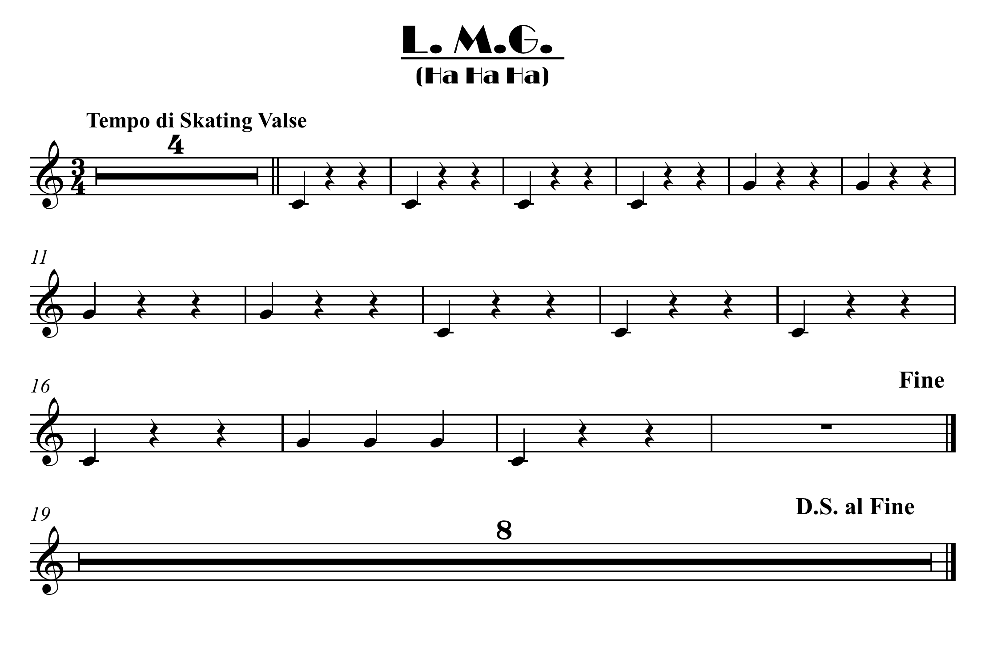
Easy bass part Bb

Slide 8

click here for note names

Slide 11
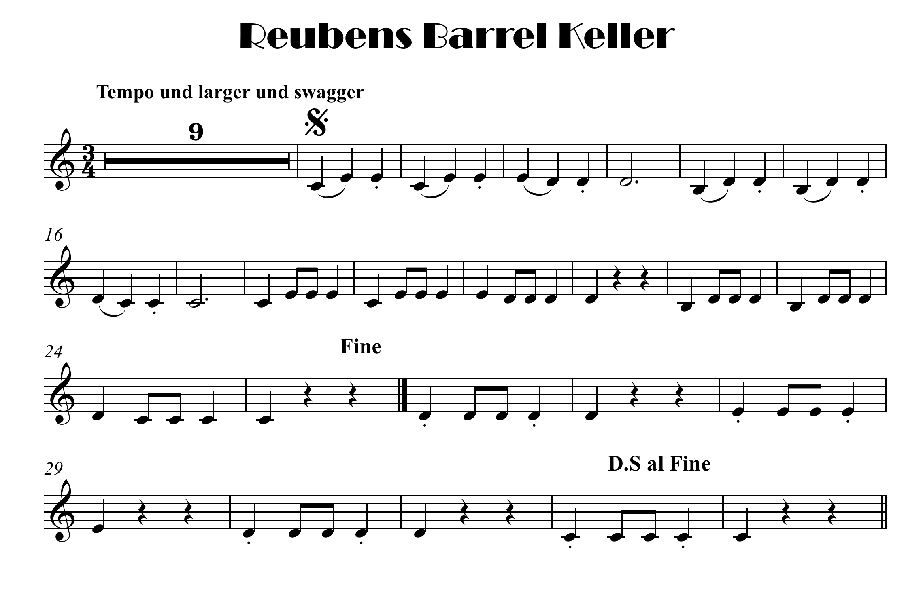
click here for note names

Slide 12
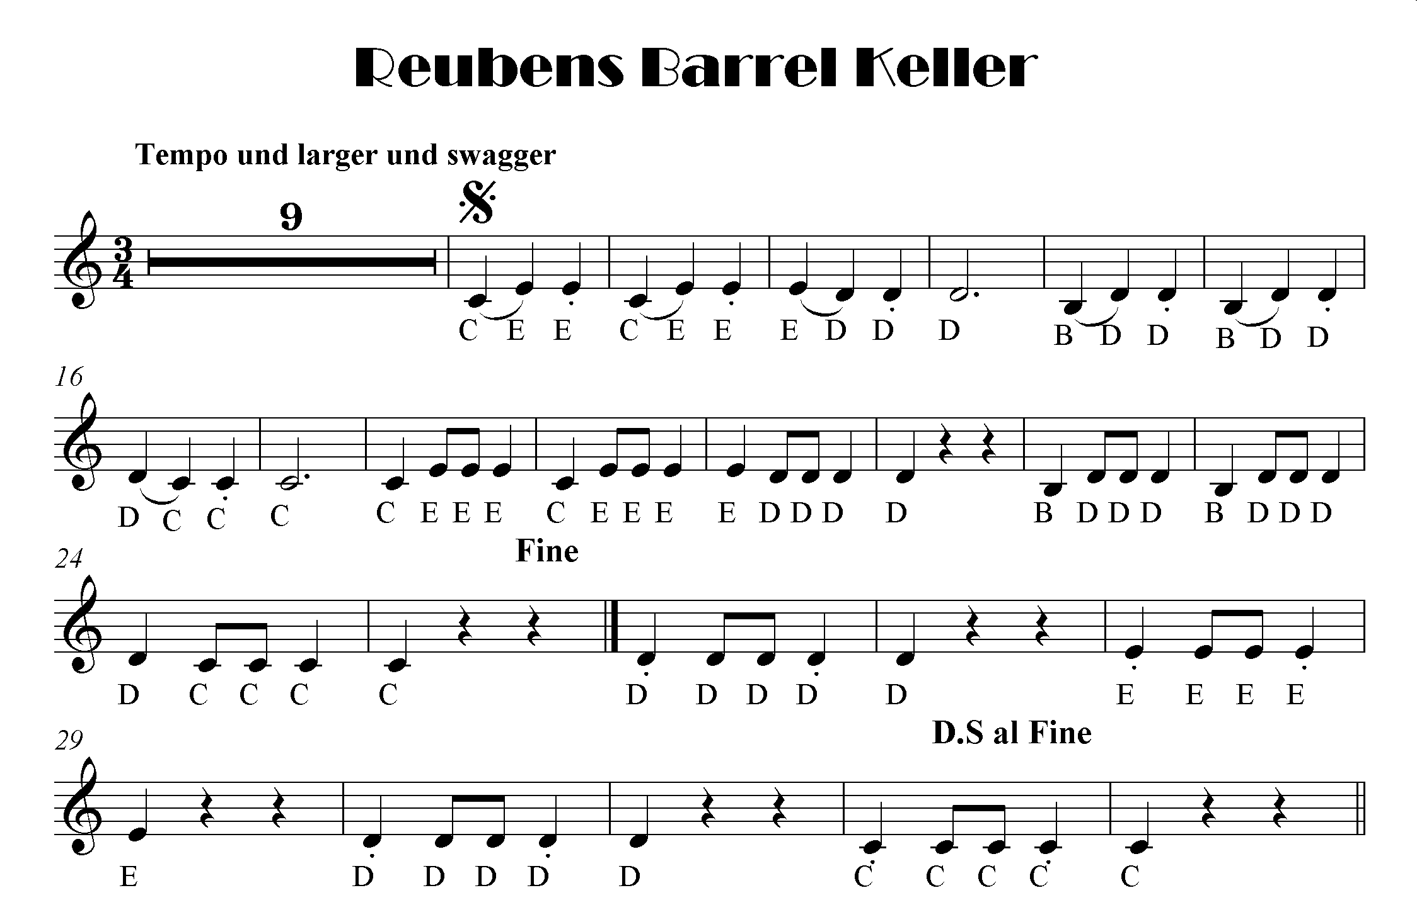

Slide 13
click here for note names

