Slide 1
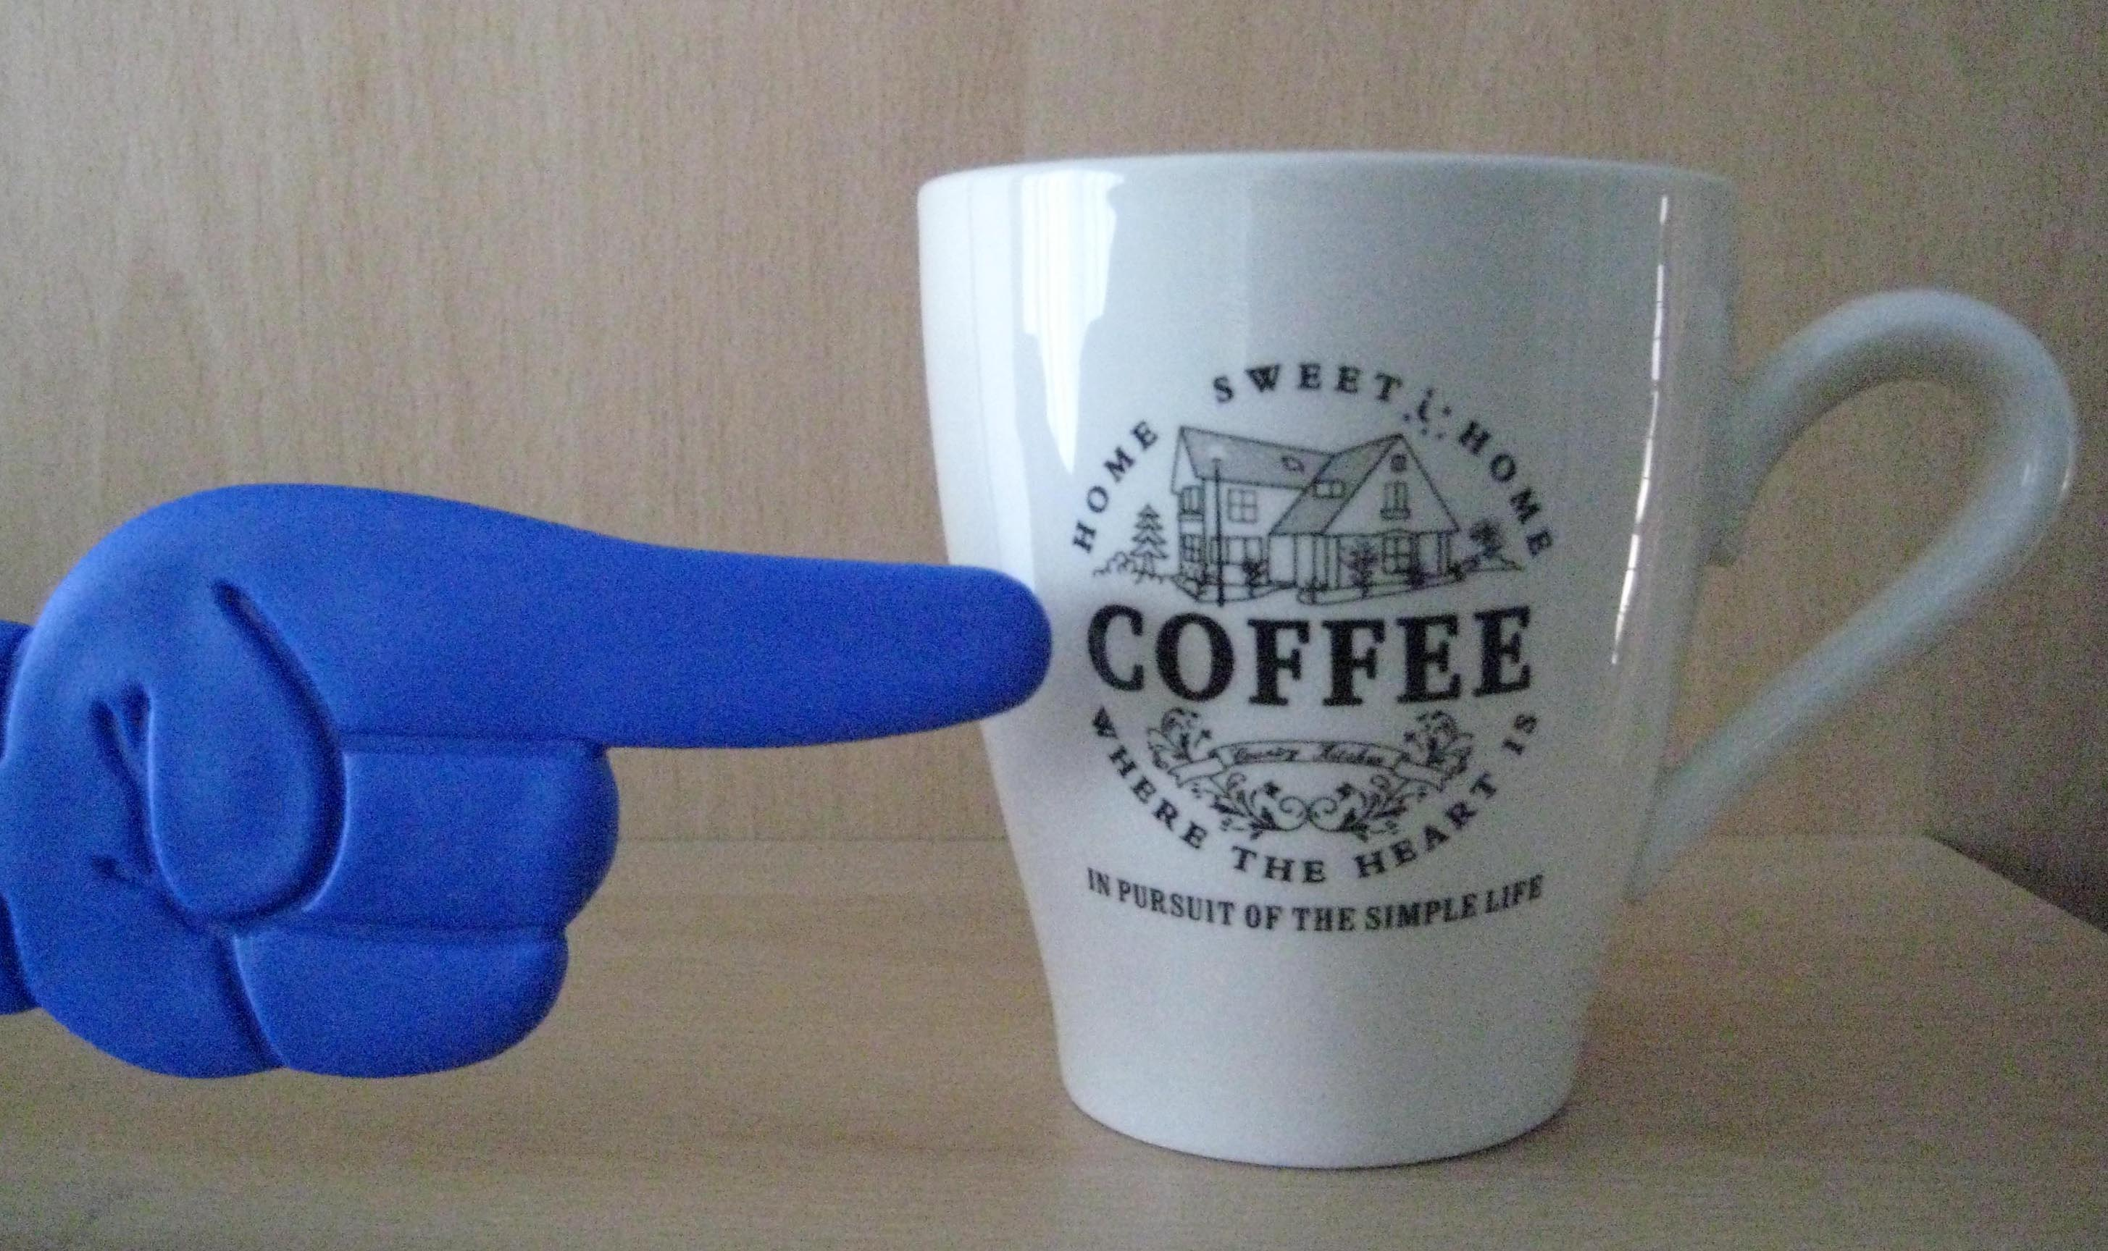

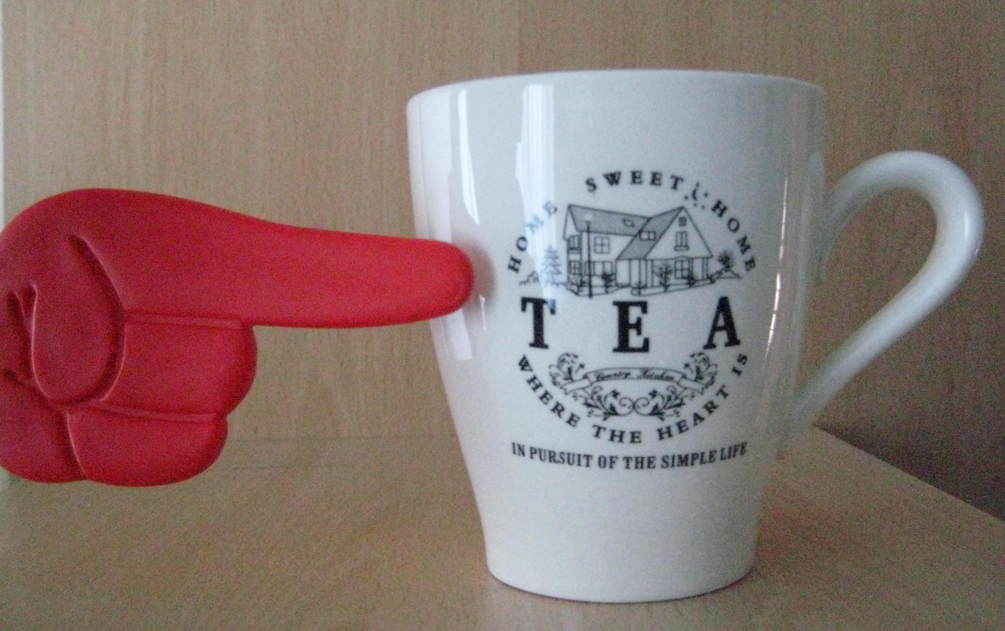



Tea or Coffee
Crotchet
Quavers
I beat
2 half beat notes

Slide 2
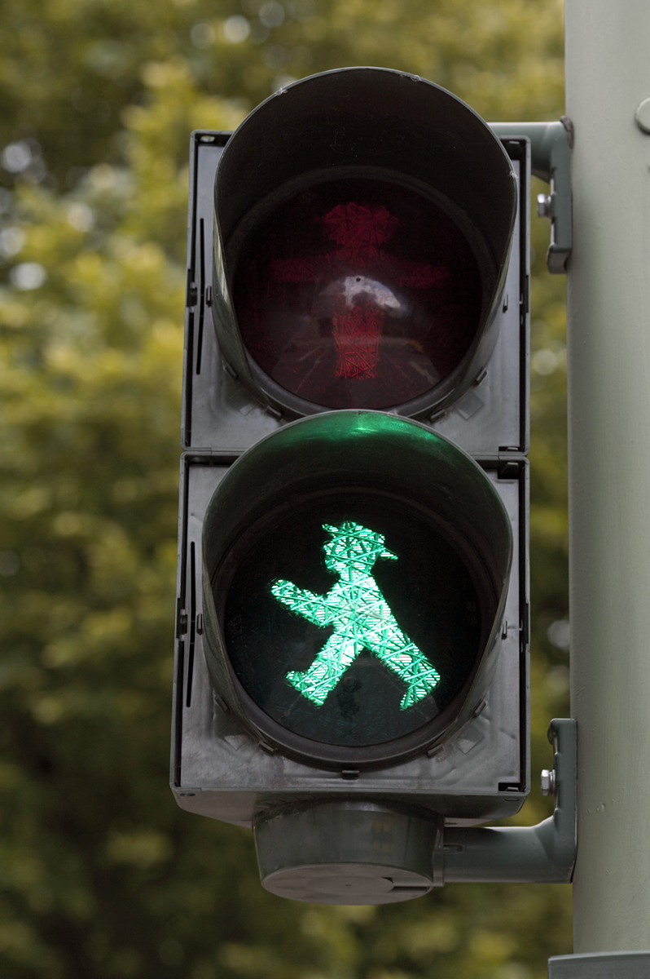

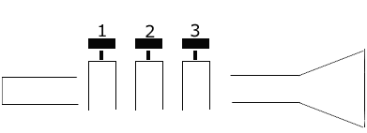
C is crossing a line
open

Slide 3



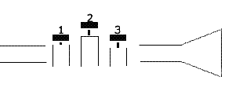
1 and 3
D is dropping off
the line

Slide 4


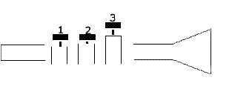
E is eating the line
1 and 2

Slide 5
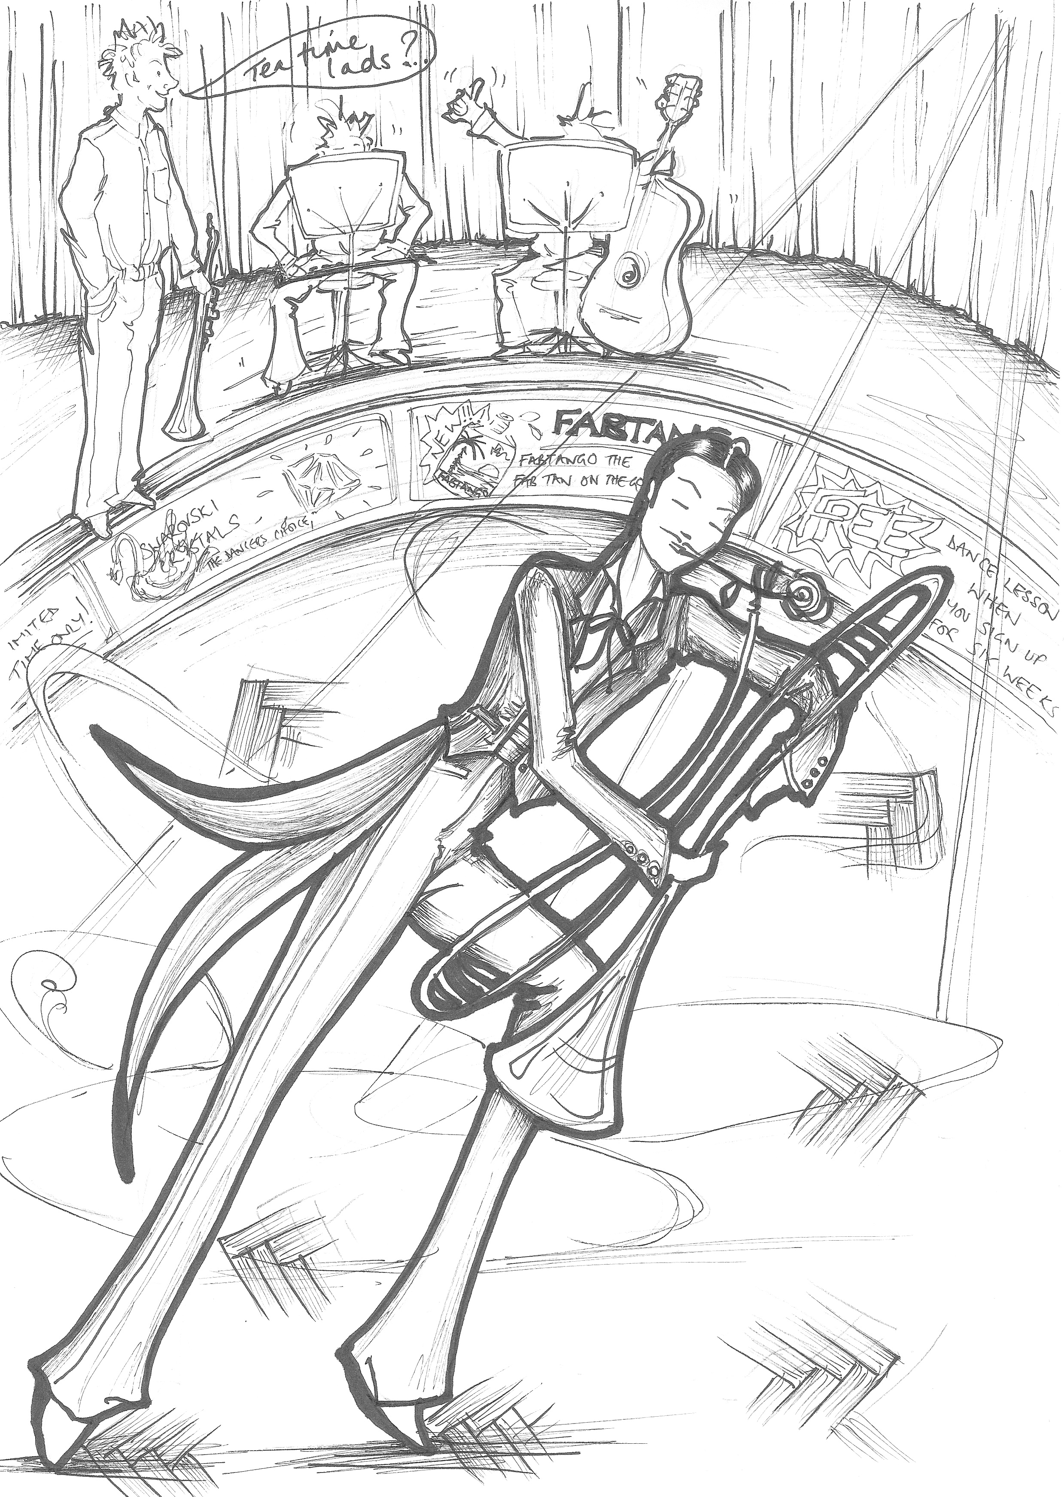
julie burton
Mr T goes for Coffee

Slide 6

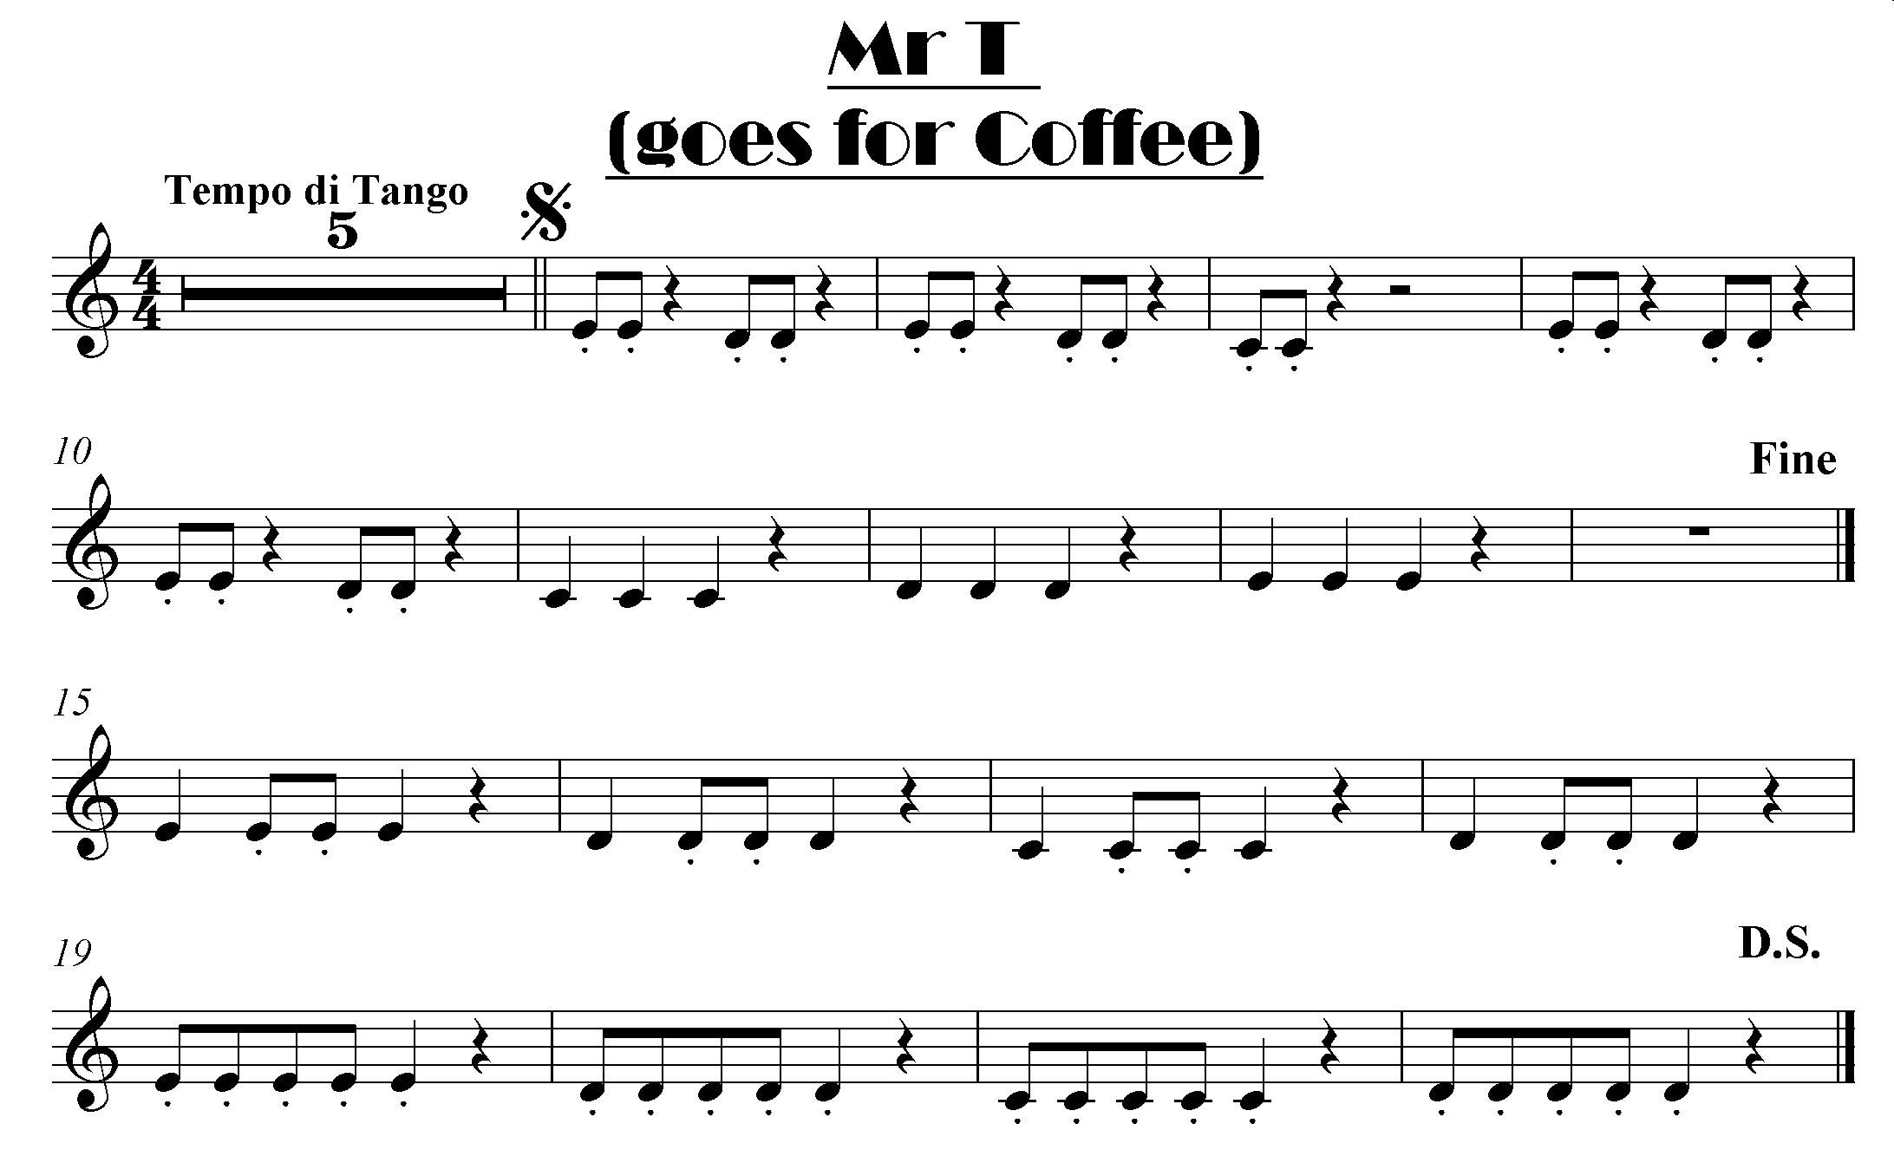

click here for note names

Slide 7
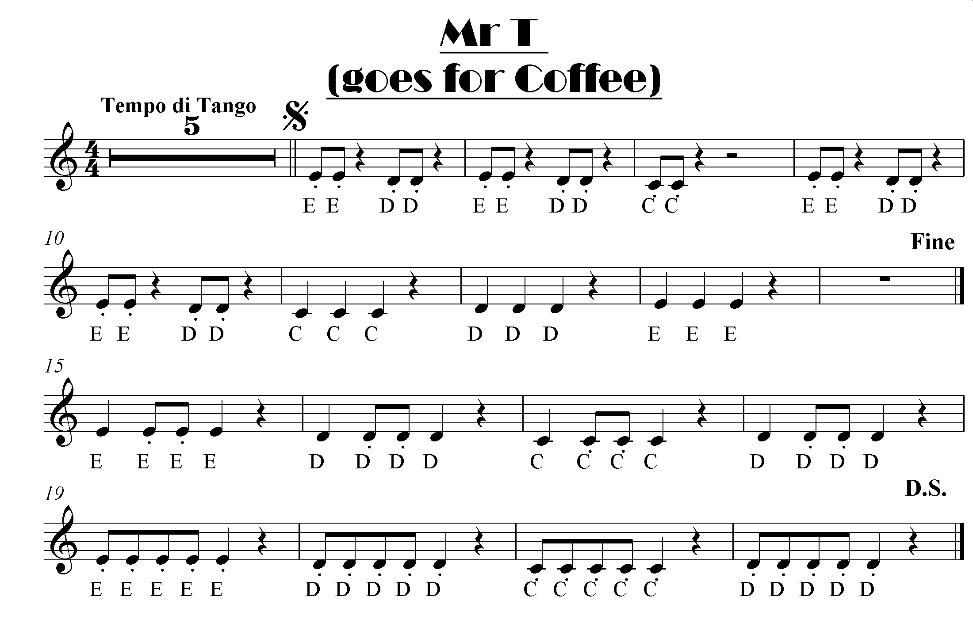

Slide 8

click here for note names

